Slide 1




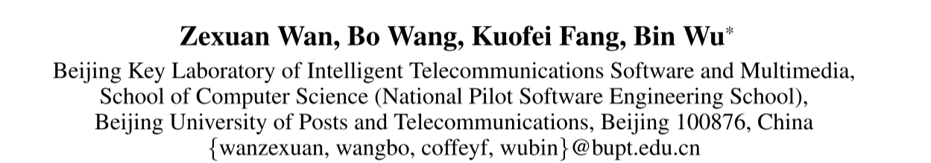



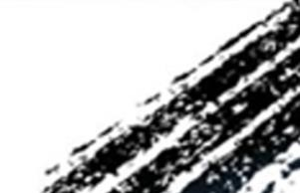

ATAI
Advanced Technique of Artificial Intelligence
ATAI
ChongqingUniversity _{AdvancedTechniqueof}
of Technology Artificial Intelligence
Chongqing University of
Technology
Chongqing University ^{ATAI}
_{of Technology} Advanced Techniqueof
Artificial Intelligence
Chongqing University of Technology
Chongqing University of Technology
TGCA-LLM Time-Aware Graph-Text Contrastive Alignment for Enhancing LLMs in Temporal Knowledge Graph Completion
Code:None
——AAAI 2026
Reported by Xiang Zhang
1

Slide 2
ATAI
Advanced Technique of Artificial Intelligence
ATAI
ChongqingUniversity _{AdvancedTechniqueof}
of Technology Artificial Intelligence
Chongqing University of
Technology
Chongqing University ^{ATAI}
_{of Technology} Advanced Techniqueof
Artificial Intelligence
Chongqing University of Technology
Chongqing University of Technology
Motivation
1)Existing methods have made progress in static KGs reasoning, but overlook temporal patterns in TKGs.
2)Existing methods rely on ideal graph models to obtain graph embeddings as idealized structural representations. However, obtaining ideal graph models requires high-quality labeled data. Meanwhile, when the graph models are suboptimal due to the noise and longtail issues, the reasoning ability of LLMs are limited.
3)Existing methods emphasize graph-language alignment but fail to incorporate temporal dimension that are essential for TKGC reasoning.

Slide 3
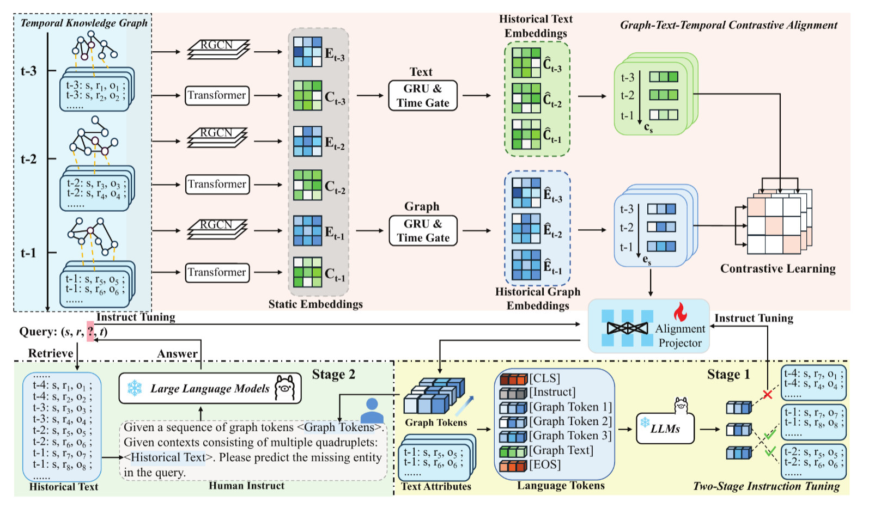
ATAI
Advanced Technique of Artificial Intelligence
ATAI
ChongqingUniversity _{AdvancedTechniqueof}
of Technology Artificial Intelligence
Chongqing University of
Technology
Chongqing University ^{ATAI}
_{of Technology} Advanced Techniqueof
Artificial Intelligence
Chongqing University of Technology
Chongqing University of Technology
Overview

Slide 4
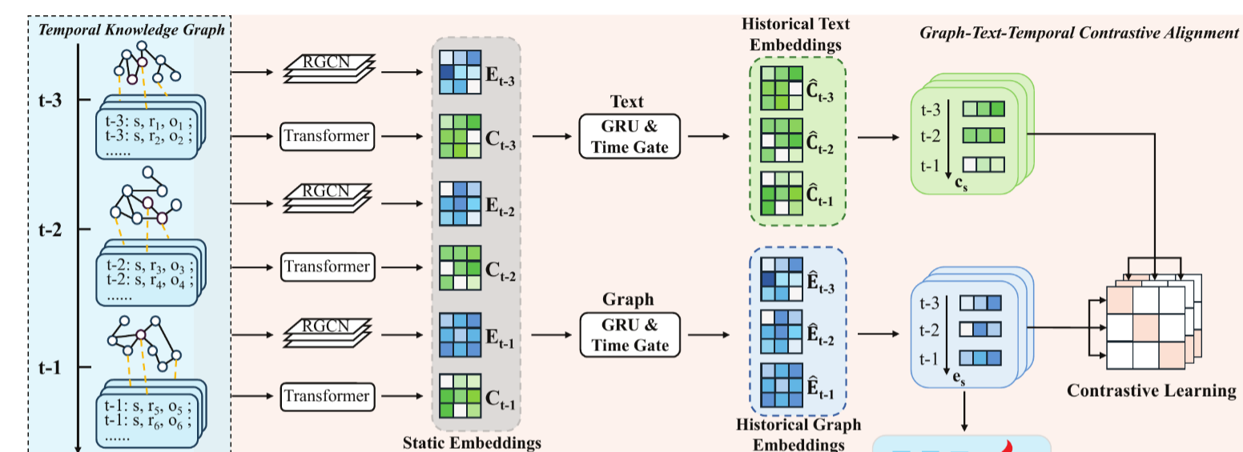
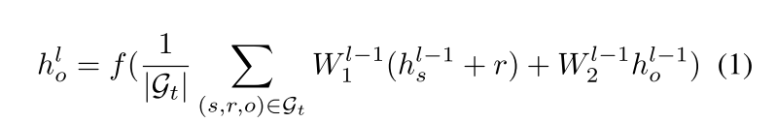
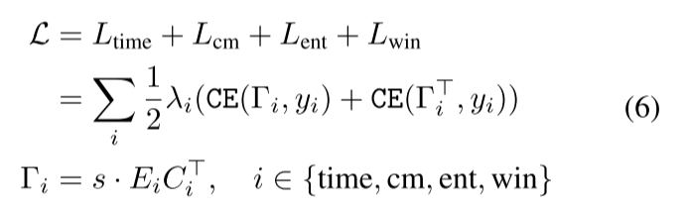

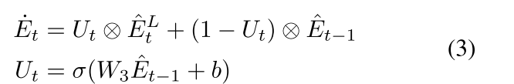
ATAI
Advanced Technique of Artificial Intelligence
ATAI
ChongqingUniversity _{AdvancedTechniqueof}
of Technology Artificial Intelligence
Chongqing University of
Technology
Chongqing University ^{ATAI}
_{of Technology} Advanced Techniqueof
Artificial Intelligence
Chongqing University of Technology
Chongqing University of Technology
Method

Slide 5
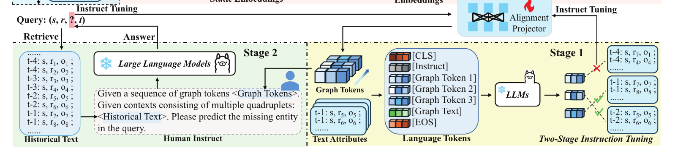
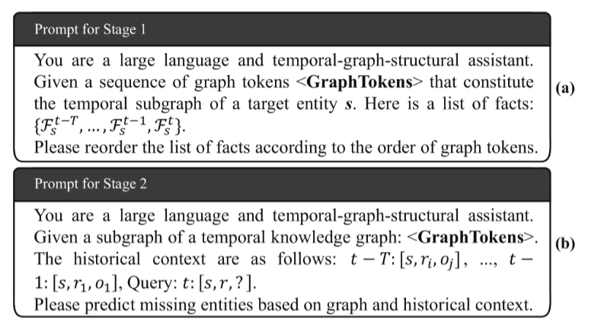
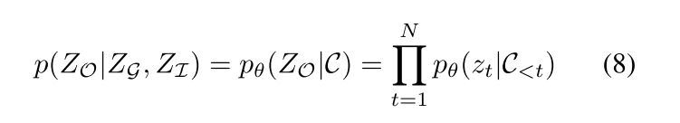
ATAI
Advanced Technique of Artificial Intelligence
ATAI
ChongqingUniversity _{AdvancedTechniqueof}
of Technology Artificial Intelligence
Chongqing University of
Technology
Chongqing University ^{ATAI}
_{of Technology} Advanced Techniqueof
Artificial Intelligence
Chongqing University of Technology
Chongqing University of Technology
Method

Slide 6
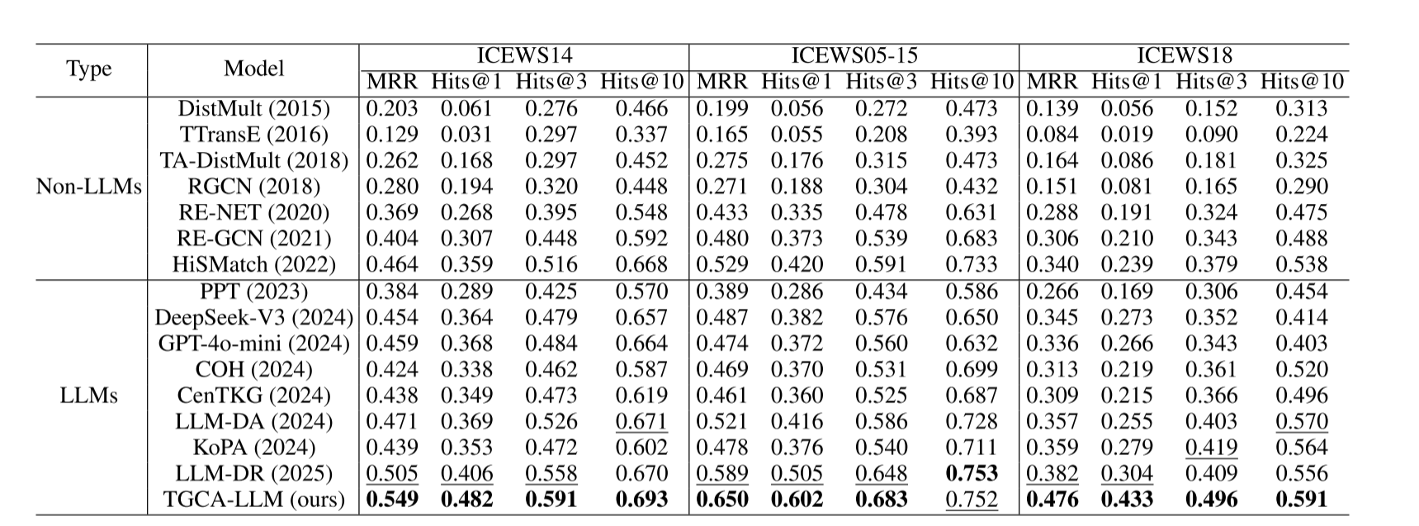
ATAI
Advanced Technique of Artificial Intelligence
ATAI
ChongqingUniversity _{AdvancedTechniqueof}
of Technology Artificial Intelligence
Chongqing University of
Technology
Chongqing University ^{ATAI}
_{of Technology} Advanced Techniqueof
Artificial Intelligence
Chongqing University of Technology
Chongqing University of Technology
Experiments

Slide 7
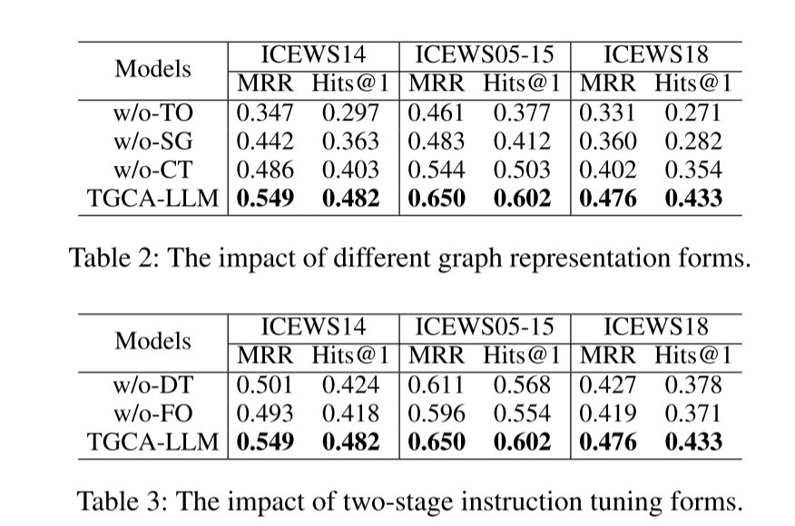
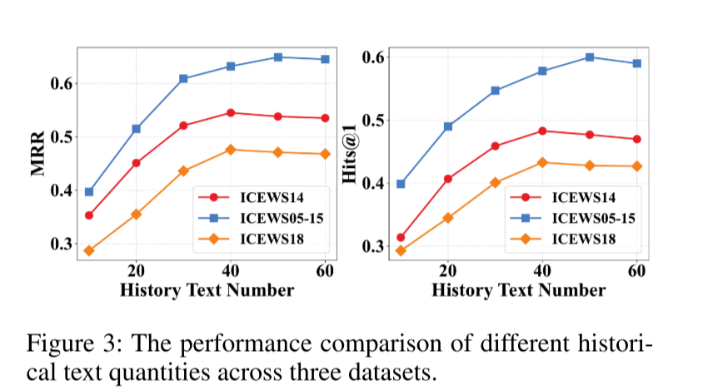
ATAI
Advanced Technique of Artificial Intelligence
ATAI
ChongqingUniversity _{AdvancedTechniqueof}
of Technology Artificial Intelligence
Chongqing University of
Technology
Chongqing University ^{ATAI}
_{of Technology} Advanced Techniqueof
Artificial Intelligence
Chongqing University of Technology
Chongqing University of Technology
Experiments

Slide 8
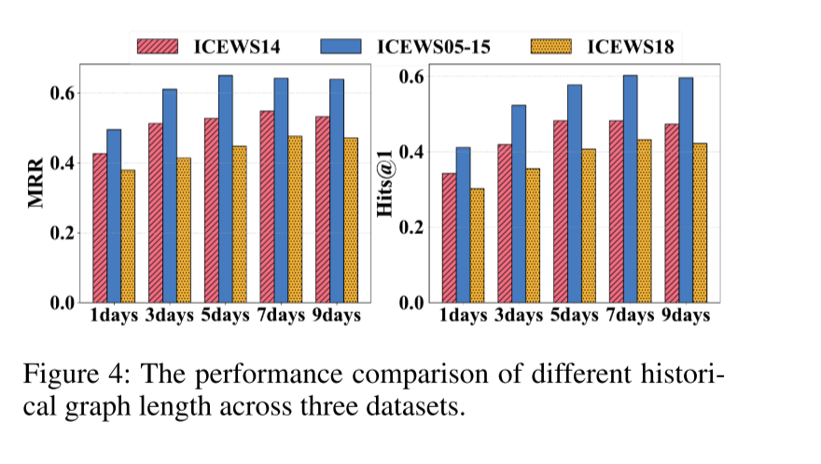
ATAI
Advanced Technique of Artificial Intelligence
ATAI
ChongqingUniversity _{AdvancedTechniqueof}
of Technology Artificial Intelligence
Chongqing University of
Technology
Chongqing University ^{ATAI}
_{of Technology} Advanced Techniqueof
Artificial Intelligence
Chongqing University of Technology
Chongqing University of Technology
Experiments

Slide 9


ATAI
Advanced Technique of Artificial Intelligence
ATAI
ChongqingUniversity _{AdvancedTechniqueof}
of Technology Artificial Intelligence
Chongqing University of
Technology
Chongqing University ^{ATAI}
_{of Technology} Advanced Techniqueof
Artificial Intelligence
Chongqing University of Technology
Chongqing University of Technology
Thanks!

